Slide 1
Map, Food, & Smiles
Yu-Chi Liao, 廖宥棋
20240419 TEN MFS.key

Slide 2

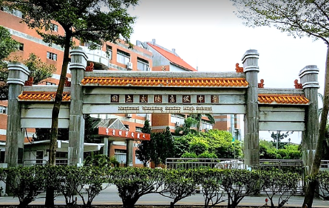
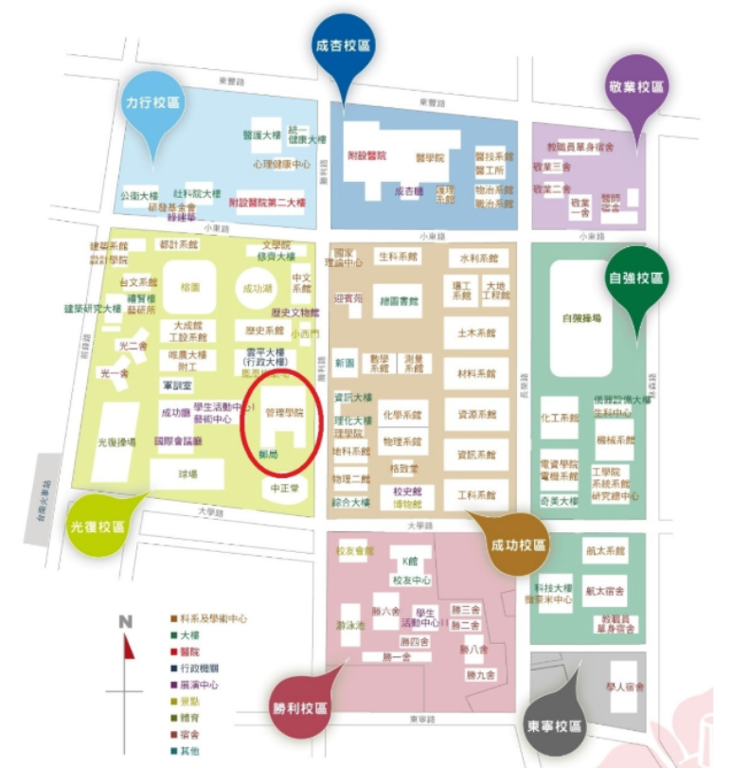

Maps
2001: Taoyuan, TW
2016-2019: Wuling High School
2019-2023 NCKU IIM
Department of Industrial and Information Management Institute of Information Management
2023-present: NYCU
Department of Information Management and Finance
Title

Slide 3
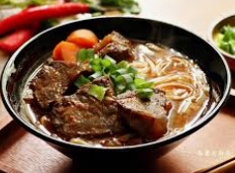
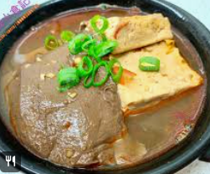

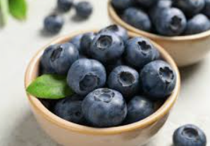
Food
Beef noodle
Spicy Stinky Tofu with Duck Blood
Blue Berry
Calbee POTATO FARM
Title

Slide 4



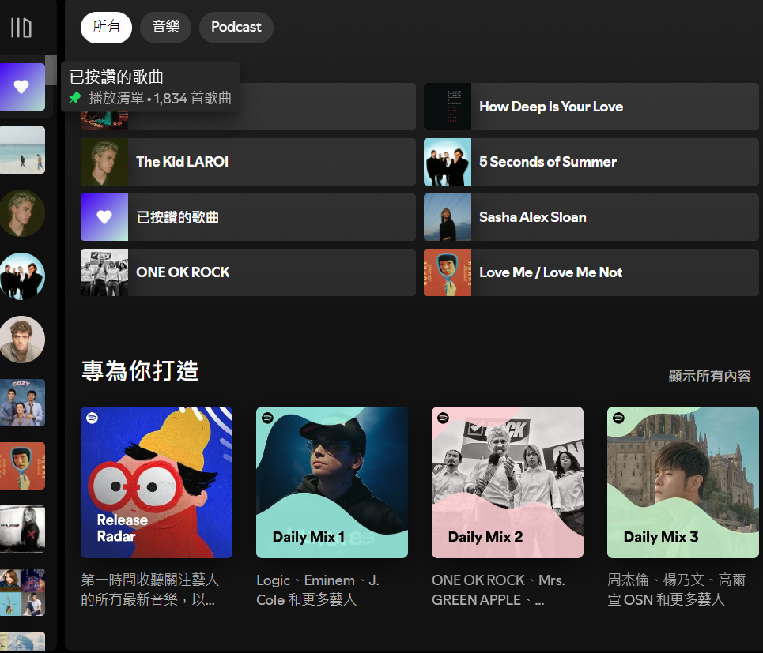
Smiles
Boxing
Travelling
Reading
Music
Title

Slide 5
Final Project
基於10K ESG文章情感分析的股價投資預測
Inspired by：An investment strategy based on news sentiment words and its emperical performance
20240419 TEN MFS.key

Slide 6
10K data web crawling
Train classifier using 10K data and ESG score
Article that support ESG score and stock price are relevant
Input newest 10K data use its output as a investment strategy reference
conclusion

Slide 7
Thanks for listening
Title

